Slide 1
CS 513: KNOWLEDGE DISCOVERY AND DATA MINING
Customer Churn Analysis

Slide 2



Team 2
Pranit Dutta
20010681
Sushil Rajeeva Bhanary
20015528
Sabitha Rachel Nazareth
20012150
Nihal Sanjay Palled
20011136

Slide 3
Problem Statement
Background: Customer churn is a significant concern for telecommunications companies, as retaining existing customers is often more cost-effective than acquiring new ones.
The objective of this project is to predict customer churn in a telecommunications company using a dataset containing customer information and historical data. By developing a predictive model, we aim to identify the most significant factors contributing to customer churn and classify customers as high or low risk of churning. This will enable the company to take proactive measures to retain customers and improve customer satisfaction.

Slide 4
Dataset Explanation
Field | Description
customerID | A unique identifier for each customer
gender | Customer's gender (Male or Female)
SeniorCitizen | Whether the customer is a senior citizen (1) or not (0)
Partner | Whether the customer has a partner (Yes or No)
Dependents | Whether the customer has dependents (Yes or No)
tenure | The number of months the customer has stayed with the company
PhoneService | Whether the customer has phone service (Yes or No)
MultipleLines | Whether the customer has multiple lines (Yes, No, or No phone service)
InternetService | Customer’s internet service provider (DSL, Fiber optic, or No)
OnlineSecurity | Whether the customer has online security (Yes, No, or No internet service)

Slide 5
Dataset Explanation
Field | Description
OnlineBackup | Whether the customer has online backup (Yes, No, or No internet service)
DeviceProtection | Whether the customer has device protection (Yes, No, or No internet service)
TechSupport | Whether the customer has tech support (Yes, No, or No internet service)
StreamingTV | Whether the customer has streaming TV (Yes, No, or No internet service)
StreamingMovies | Whether the customer has streaming movies (Yes, No, or No internet service)
Contract | The contract term of the customer (Month-to-month, One year, or Two year)
PaperlessBilling | Whether the customer has paperless billing (Yes or No)
PaymentMethod | The customer’s payment method (Electronic check, Mailed check, Bank transfer (automatic), or Credit card (automatic))
MonthlyCharges | The amount charged to the customer monthly
TotalCharges | The total amount charged to the customer
Churn | Whether the customer churned (Yes or No) - This is the target variable

Slide 6
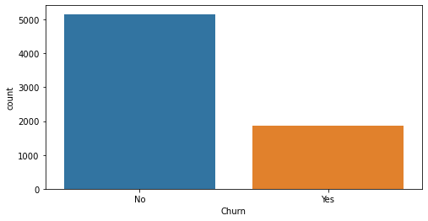
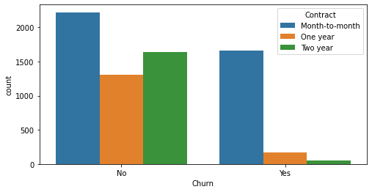
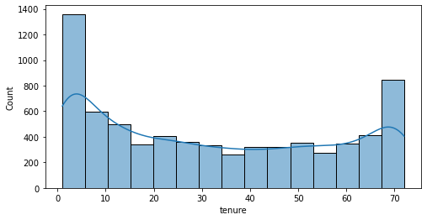
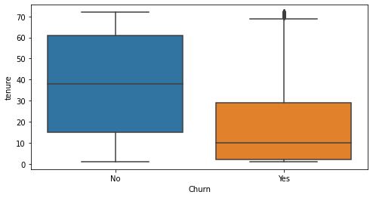
Data Processing
The data was preprocess by converting the non numerical object to integer objects by using label encoder function.
During the EDA Phase of the project we observed that there is an unbalance in the data set. The ratio of the churn to no churn was in the ratio of 3:1 . In order to handle the unbalance we used sampling technique called SMOTE-ENN.
Then feature scaling called Min-Max was applied

Slide 7
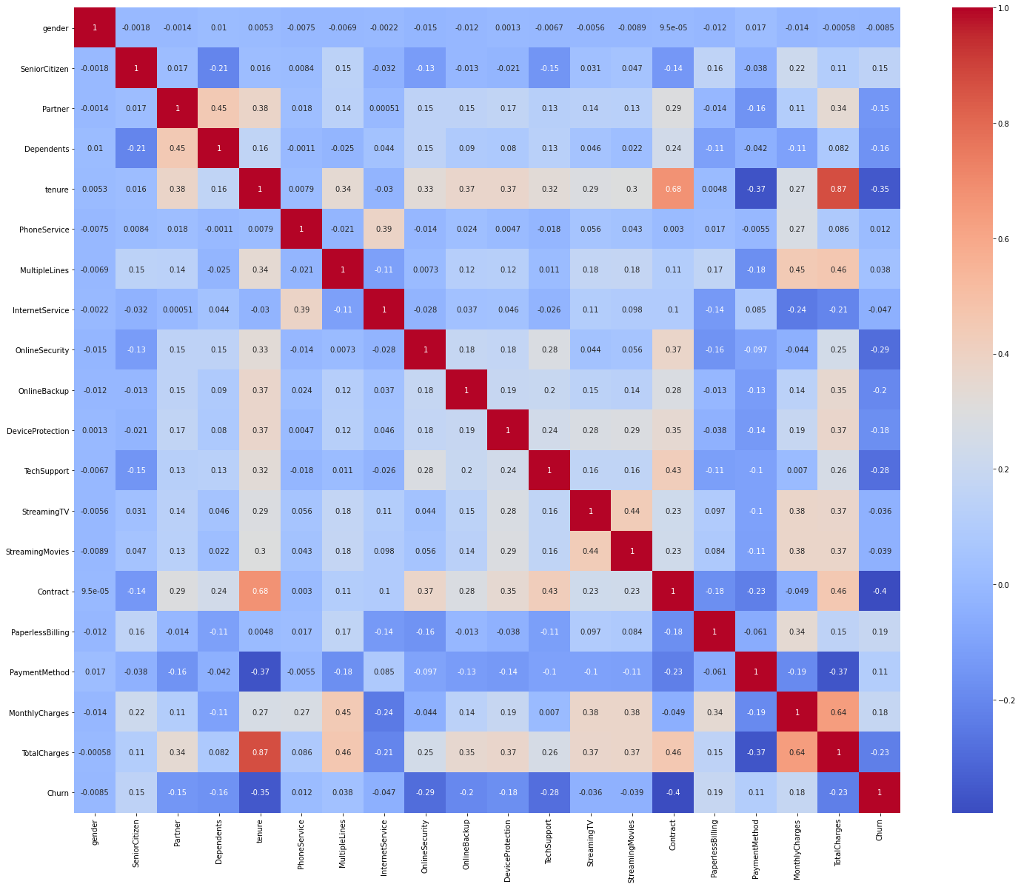
Correlation Matrix

Slide 8
MODELS
LDA
XGboost
SVM
ADA BOOST
Neural Network
Neural Network with grid search
Label prop
Naive bayes
KNN
Random Forest
Decision Tree
Logistic Regression
Bagging Classifier

Slide 9
Metrics
Accuracy
Balanced Accuracy
ROC AUC score
F1 score
Precision
Recall
Cohen’s Kappa

Slide 10
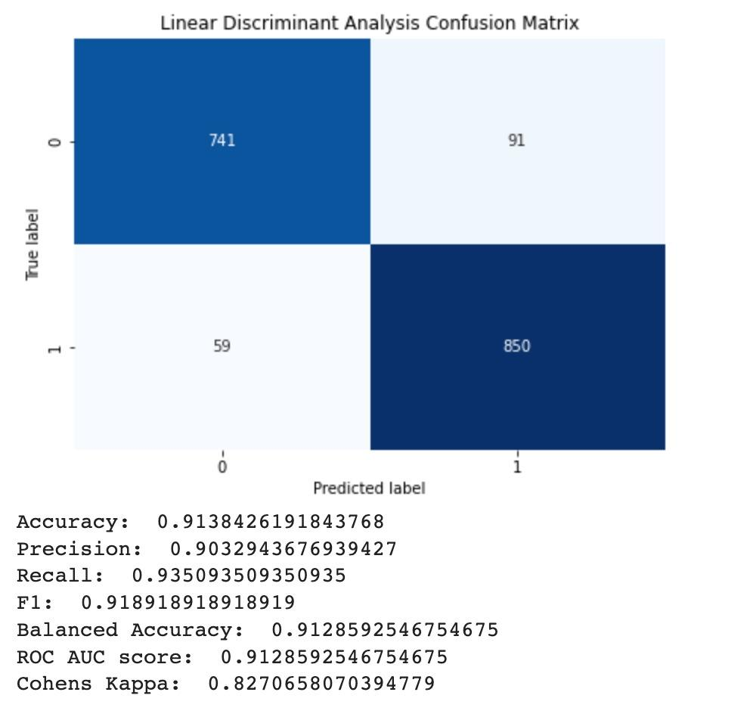
Linear Discriminant Analysis

Slide 11
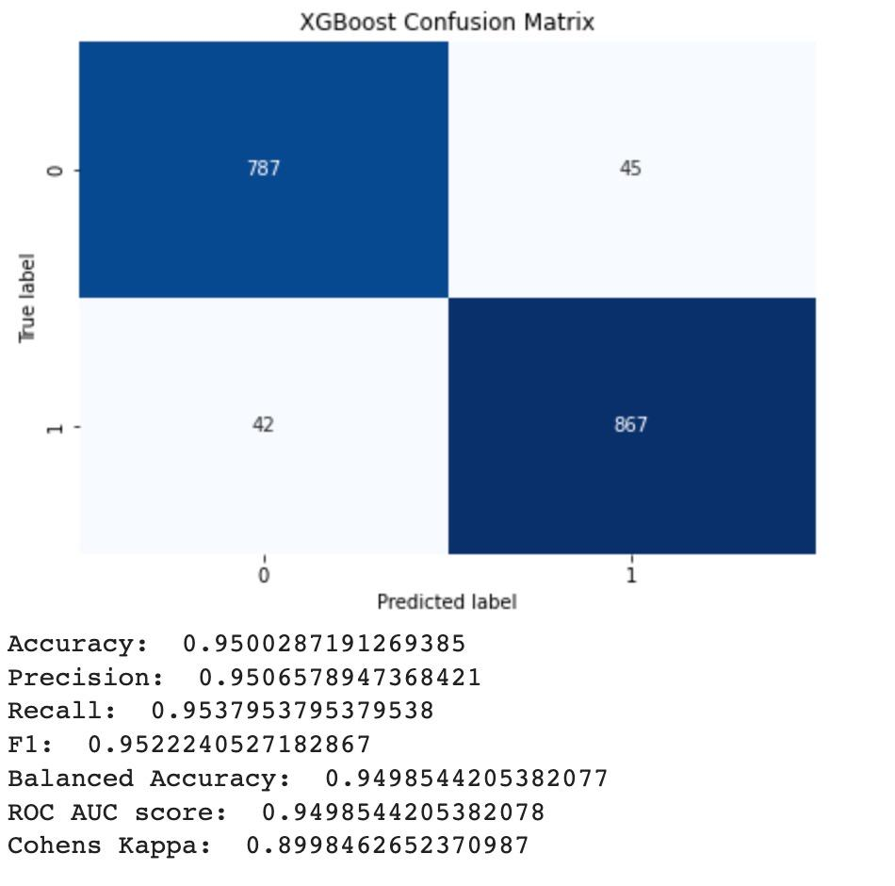
XGBoost

Slide 12
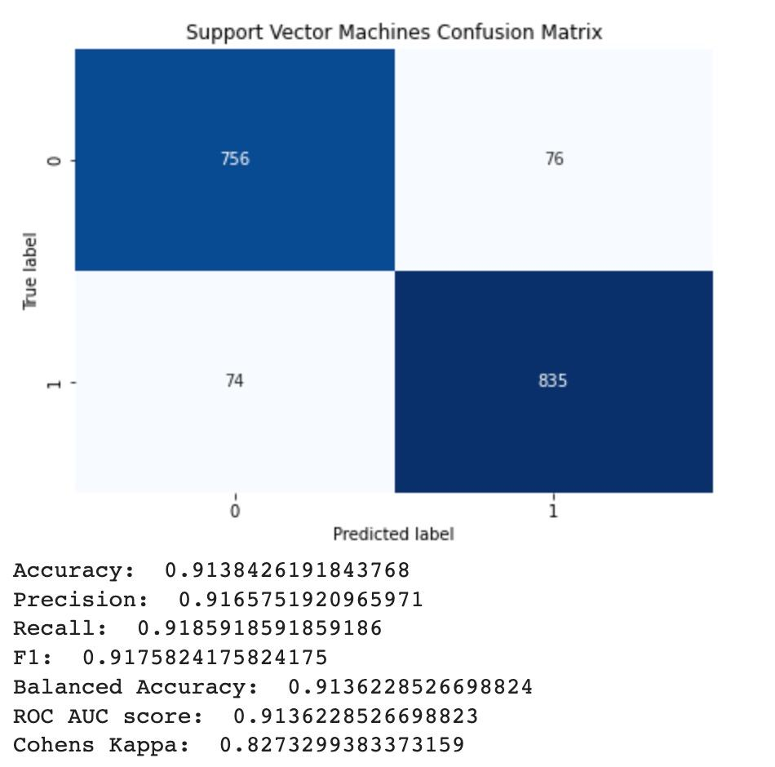
Support Vector Machine

Slide 13
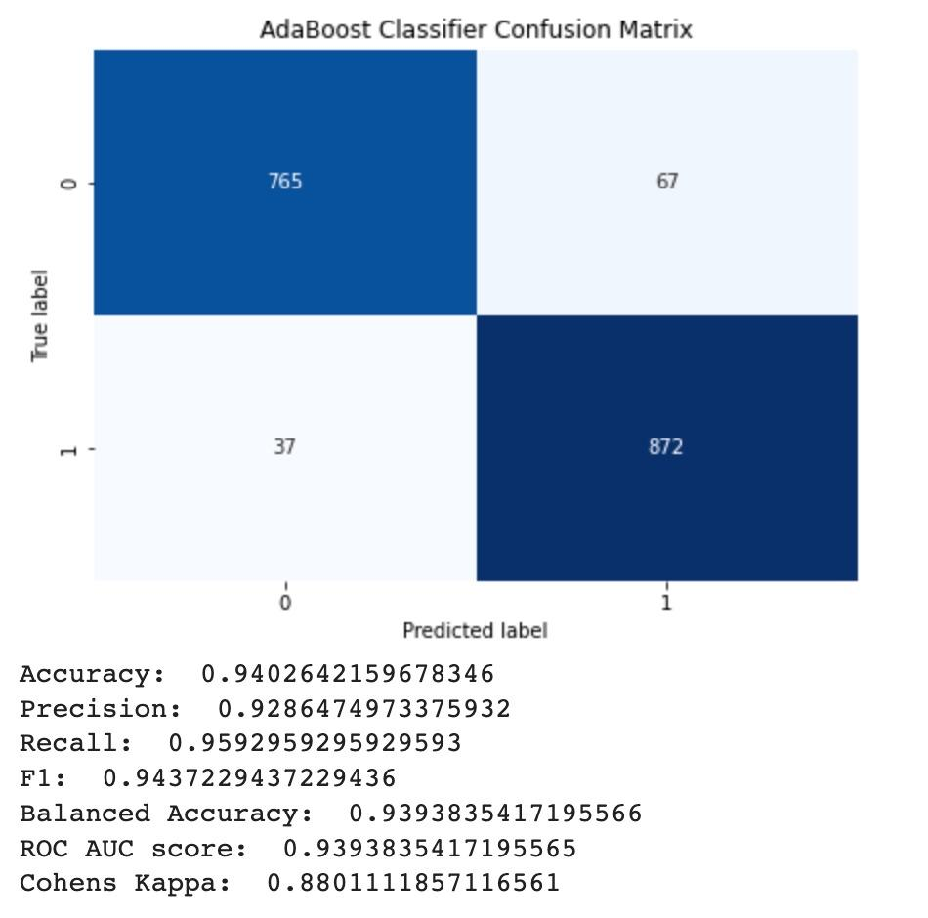
ADA Boost

Slide 14
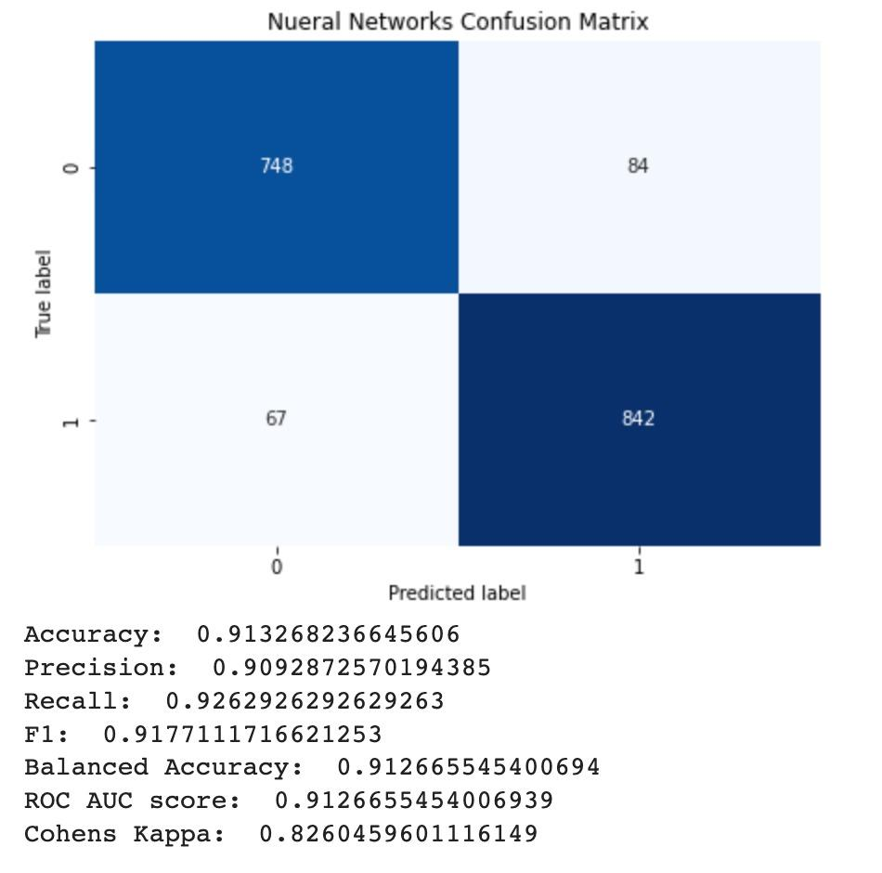
Neural Network

Slide 15
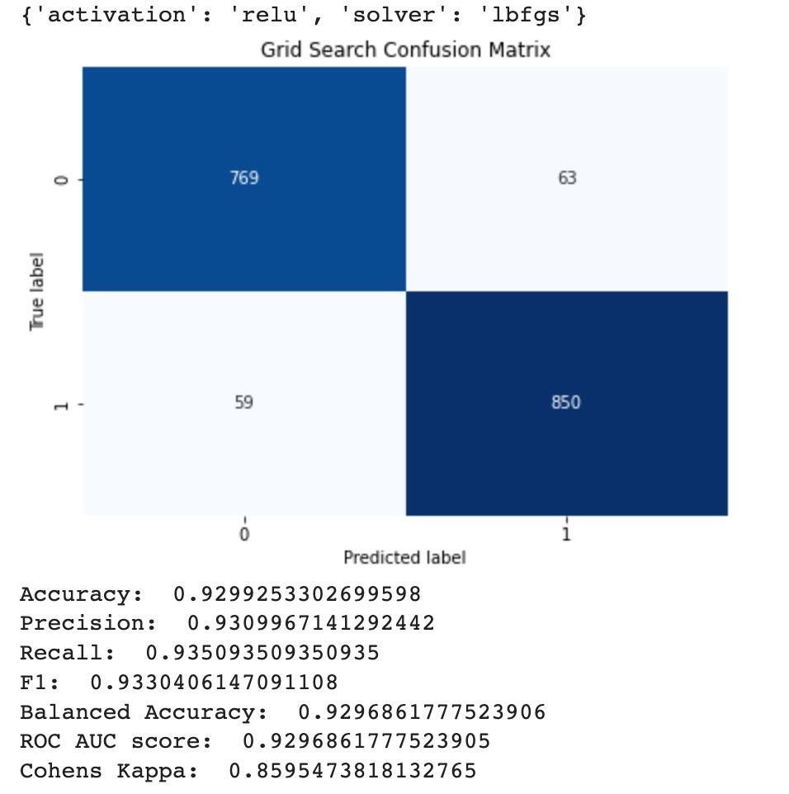
Neural Network With Grid Search

Slide 16
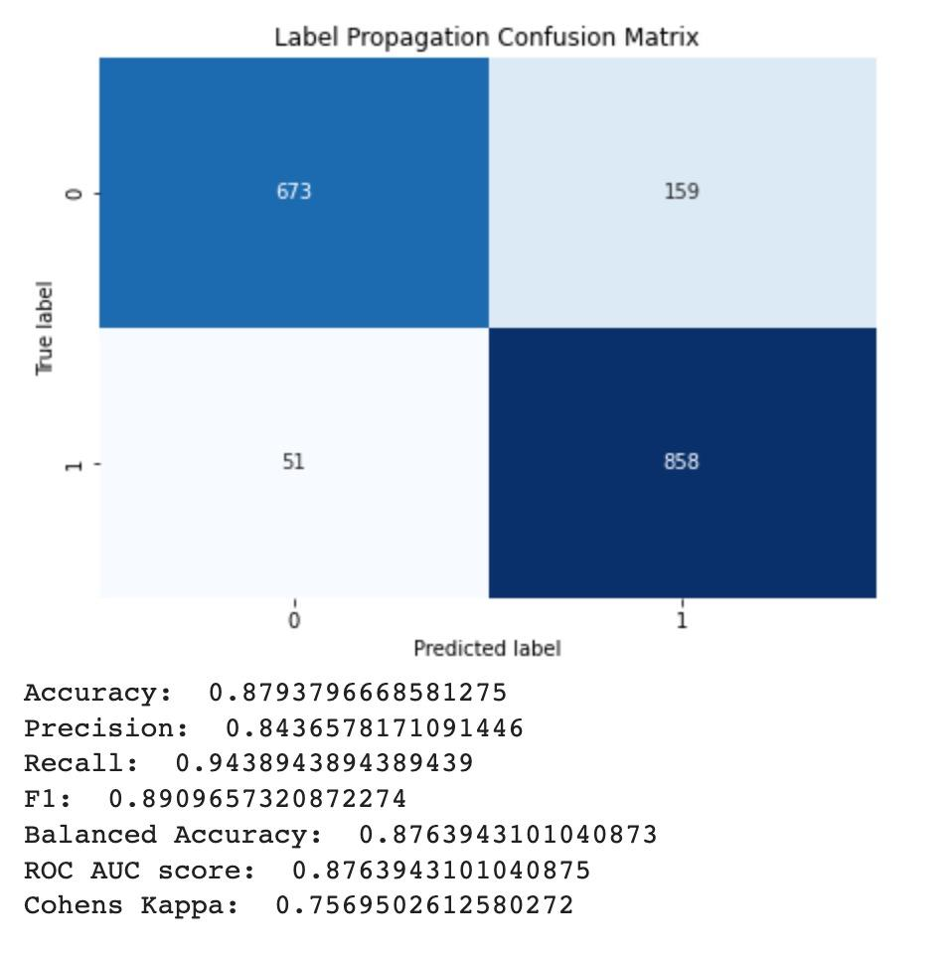
Label Propagation

Slide 17
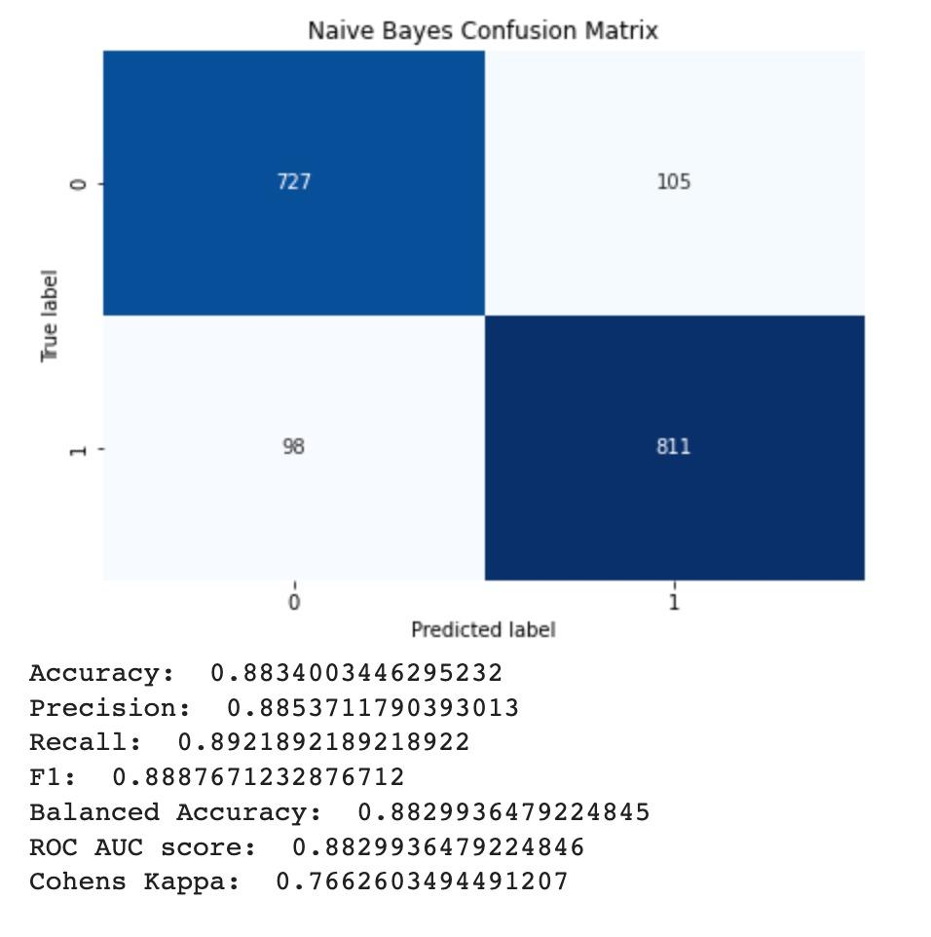
Naive Bayes

Slide 18
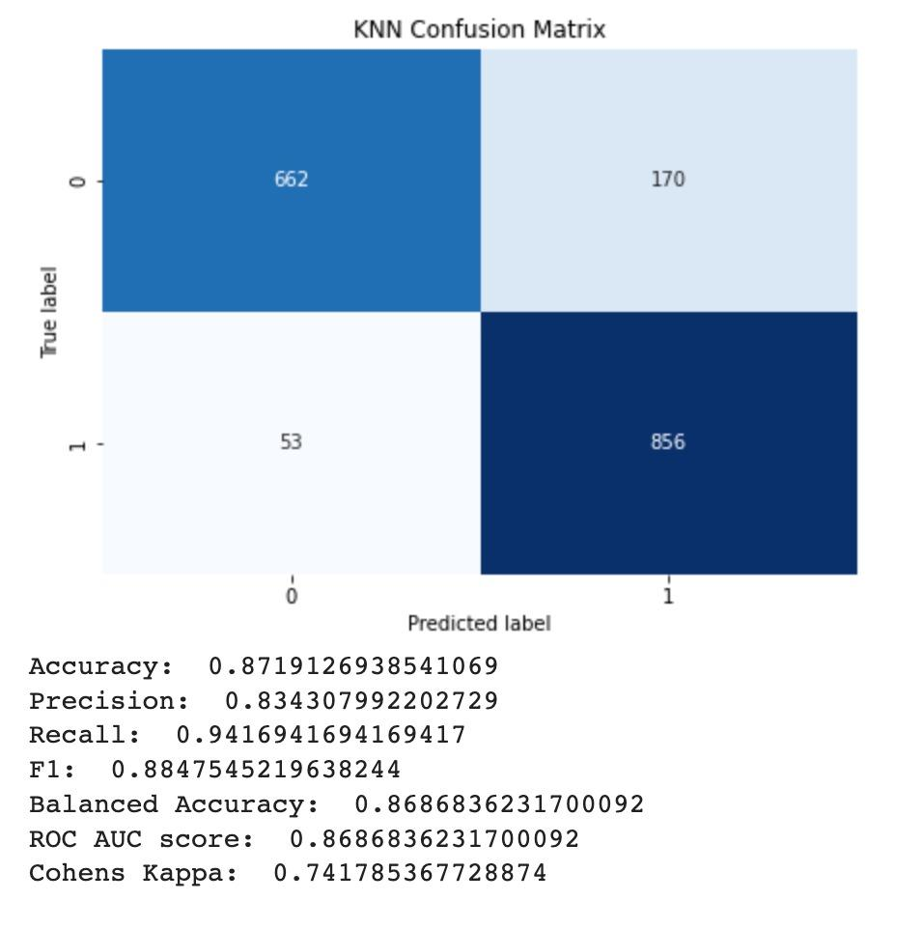
K-Nearest Neighbours

Slide 19
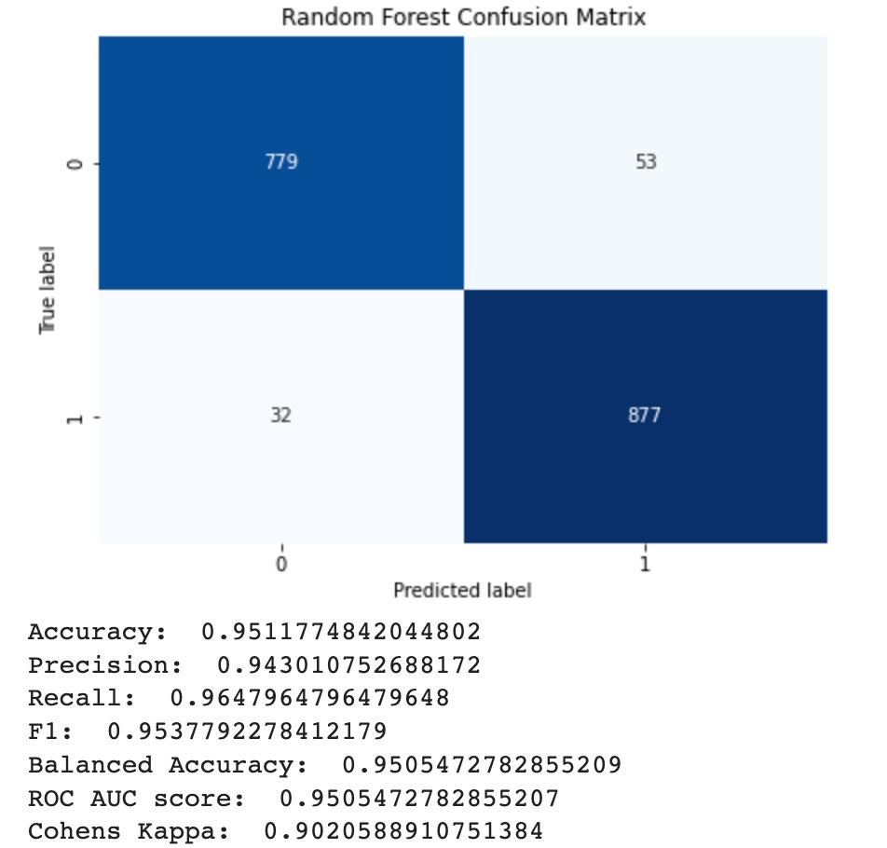
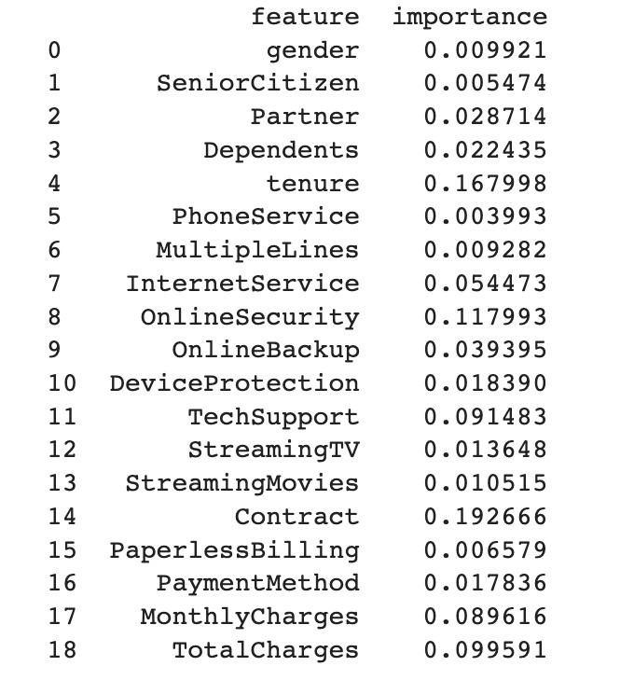
Random Forest

Slide 20
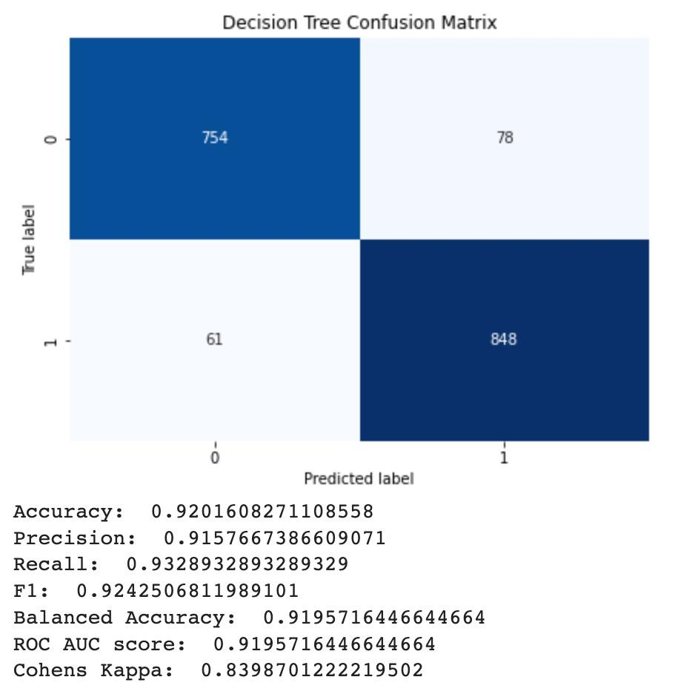
Decision Tree

Slide 21
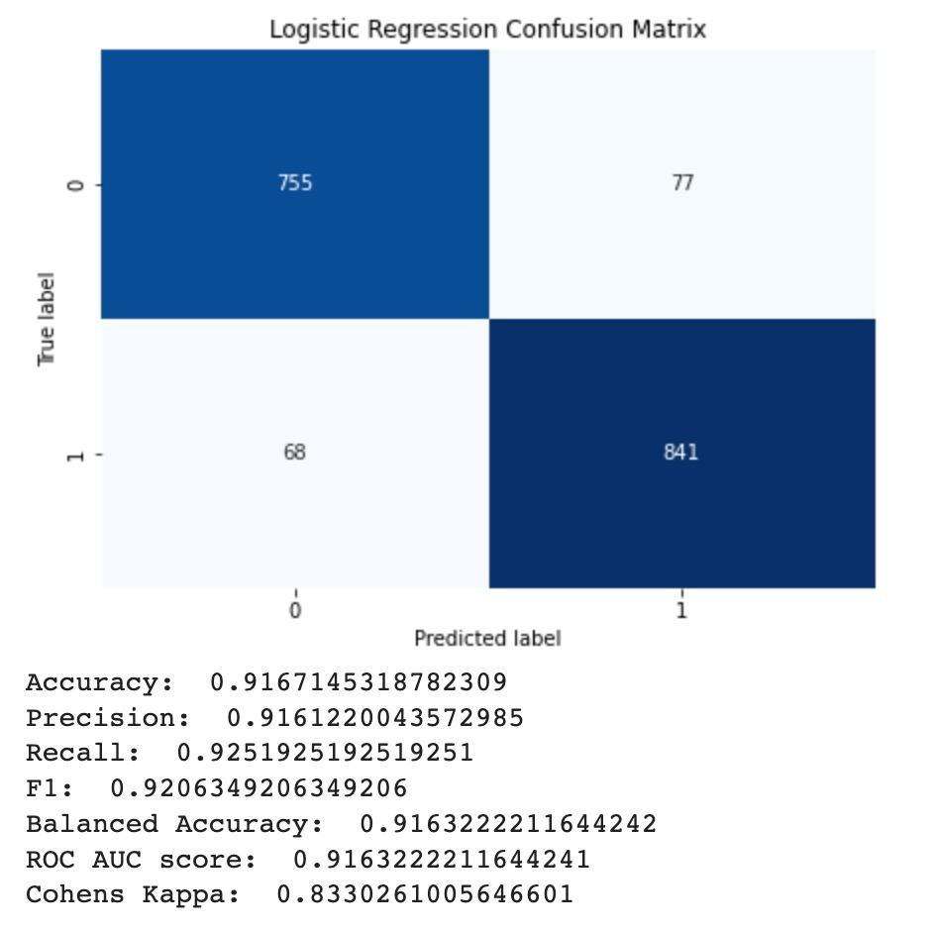
Logistic Regression

Slide 22
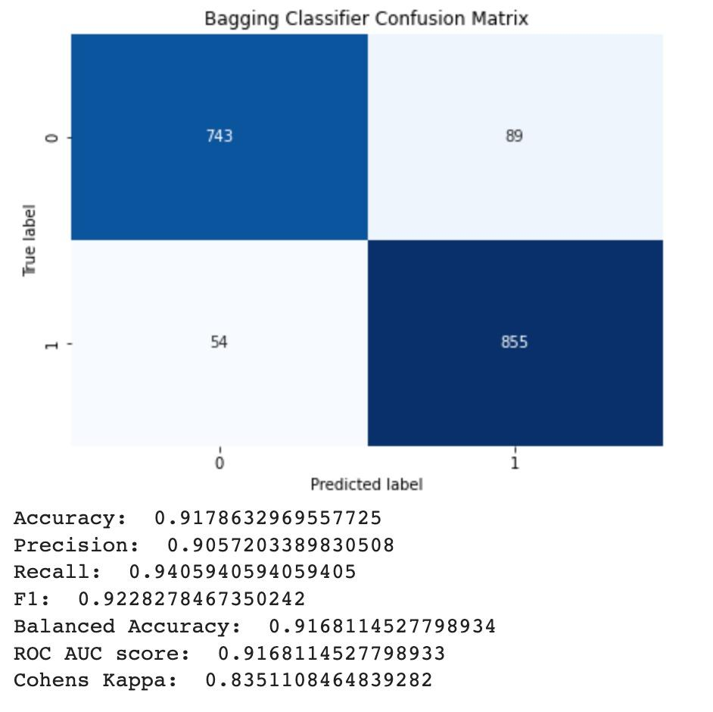
Bagging Classifier

Slide 23
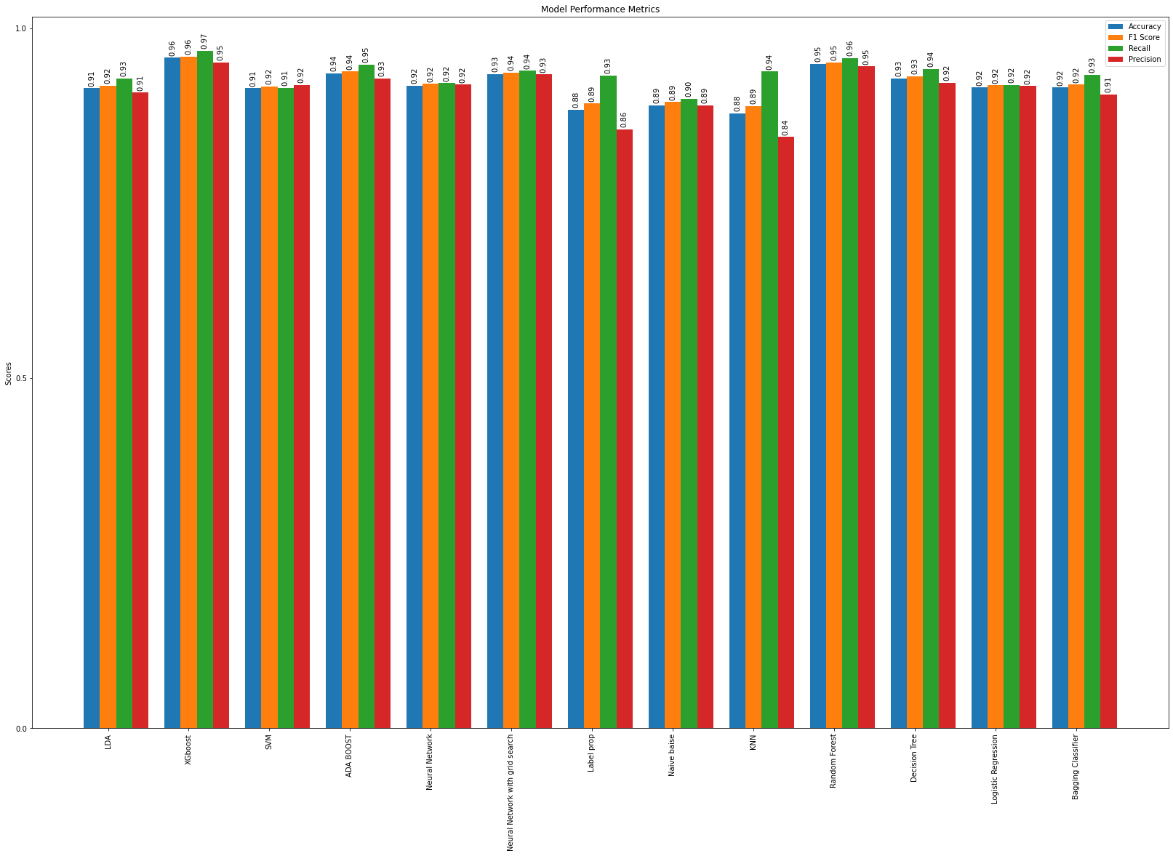

Slide 24
Final Conclusion
In conclusion, we have compared various machine learning algorithms for our dataset, including LDA, XGBoost, SVM, AdaBoost, Neural Networks, Label Propagation, Naive Bayes, KNN, Random Forest, Decision Tree, Logistic Regression, and Bagging Classifier. Based on the performance metrics (Accuracy, F1 Score, Recall, and Precision), we observed that XGBoost performed the best among all the models, followed by Random Forest and Neural Network with Grid Search.
We also observe that
Tenure has the highest importance
Features such as Partner, Dependents, DeviceProtection, StreamingTV, and StreamingMovies are less important features, with feature importance values ranging from 0.019759 to 0.011085.

Slide 25
Thanks!
Q & A

